Slide 1
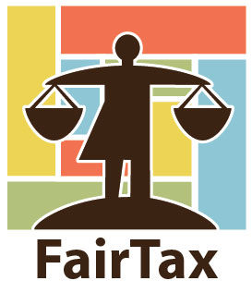
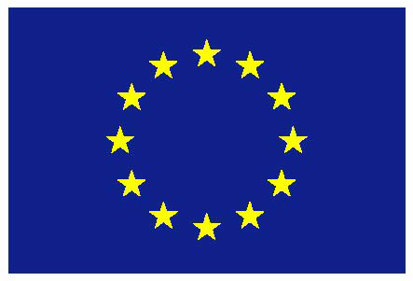
EU Taxes as Instrument to Strengthen Sustainability of Taxation in the EU
Margit Schratzenstaller
Austrian Institute of Economic Research WIFO
20th FMM Conference, October 22nd, 2016, Berlin
The project is funded by the European Union’s Horizon 2020 research and innovation programme 2014-2018, grant agreement No. FairTax 649439

Slide 2
The project in brief
Project facts
Akronym: FairTax
Duration: 4 years, from 2015-2019
Partners: 11
Coordinator: Prof. Åsa Gunnarsson, Umeå University, Sweden
In line with long-term EU strategies and challenges:
EU2020 strategy; renewed EU Sustainable Development Strategy; Sustainable Development Goals; Paris Agreement…
H2020-Societal Challenges (EURO-SOCIETY-2014. OVERCOMING THE CRISIS: NEW IDEAS, STRATEGIES AND GOVERNANCE STRUCTURES FOR EUROPE)

Slide 3
Objectives
Options for expanding EU legislative competences, or other governance mechanisms, enabling the EU to effectively harmonise and coordinate Member States' tax and social policies.
Reform options for state-level coordination to create fairer, more stable and sustainable tax and social policy regimes.
Strategies for the increased effectiveness and harmonisation of tax administration and compliance structures within the EU and non-EU areas.
Recommendations for true own-source EU revenues.
.

Slide 4
FairTax work packages and research topics
Critical Assessment of EC Jurisdiction over Tax Policy Norms: Aspirations,Obligations, and Barriers
Harmonising EU Tax Bases, Tax Rates, and Tax Mixes: Growth, Fairness, and Sustainability
Gender Equality, Income Inequalities, and Coordinating the Individualisation of Tax-Benefit Unit Laws in EU Fiscal Policy
European Pension Policies and Intergenerational Fiscal Sustainability, Fairness, and Consolidation
Increasing Sustainability and Competitiveness by Harmonising and Coordinating EU Corporate Tax Bases
Co-producing Tax Compliance: Tax Agency Mobilisation of Taxpayers, Businesses, and Third Parties (Nordic Countries)
Tax Risk Management and Large Businesses: Cooperative Compliance Initiatives and the Role of Tax Advisors in Corporate Tax Policy and Practice (UK/Ireland and the Nordic Countries)
Sustainability-oriented Options for EU Own Resources

Slide 5
FairTax partners
(Coordinator) Åsa Gunnarsson, Umeå University Sweden
Lotta Björklund Larsen, Linköping University Sweden
Benedicte Brögger, Handelshöyskolen BI Norway
Karen Boll, Copenhagen Business School Denmark
Ann Mumford, King’s College London UK
Lynne Oates, University of Exeter UK
Emer Mulligan, National University of Ireland, Galway Ireland
Margit Schratzenstaller, WIFO Austria
Dana Nerudová, Mendel University Czech Republic
Kathleen Lahey, Queen’s University at Kingston Canada
Leonel Cesarino Pessôa, Getulio Vargas Foundation Law School Brazil

Slide 6
WP 8: Sustainability-oriented future EU funding
EU current system of own resources: historical development and criticism
Identification of fundamental pros and cons of tax-based own resources as an alternative own resource
Widening the perspective by innovative comprehensive concept of sustainability-oriented taxation
Establishing evaluation criteria capturing the four dimensions of sustainability relevant for taxation
Development and analysis/evaluation of candidates for sustainability-oriented tax based own resources

Slide 7
Rationale for sustainability-oriented tax-based own resources
Current system of EU own resources does not contribute to central EU objectives: “smart, sustainable, inclusive growth” according to Europe 2020 strategy; SDG…
Sustainability-oriented tax-based own resources may reduce/ compensate for sustainability gaps in EU Member States’ tax regimes

Slide 8
Sustainability gaps in taxation in EU
High and increasing weight of labour taxes
average 50% on overall tax revenues in EU15 (EU28)
Decreasing progressivity of tax systems
increasing weight of VAT means increasing regressive distributional effects
redistributive power of taxation has weakened
Decreasing importance of Pigovian taxes
primary objective of environmental taxes is generation of additional revenues
taxes on financial sector play limited role
Intense tax competition
Decrease of nominal corporate tax rate from 35% in 1995 to 23% in 2015 EU average
accompanied by profit shiftingcorporate income tax losses EUR 50-70 bn. in EU
Tax compliance and tax fraud

Slide 9
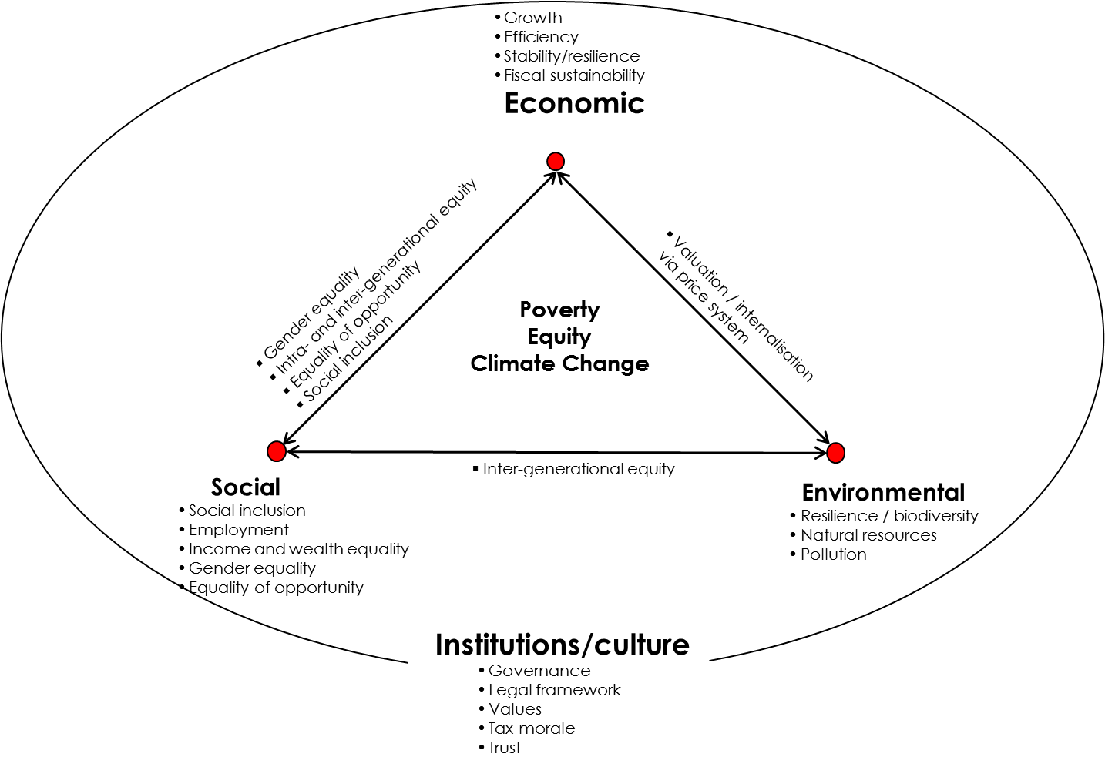
Sustainability gaps in taxation in EU

Slide 10
Evaluation criteria for (tax-based) EU own resources
Criteria established by European Commission/HLGOR
Conventional criteria in literature
Sustainability-oriented criteria

Slide 11
Sustainability-oriented evaluation criteria for (tax-based) EU own resources (1)
Economic sustainability
Economic growth
Fiscal sustainability
Economic welfare
Social sustainability
Employment
Social inclusion, cohesion and mobility
Wellbeing and quality of life

Slide 12
Sustainability-oriented evaluation criteria for (tax-based) EU own resources (2)
Environmental sustainability
Air pollution
Green innovation
Renewable energy
Cultural/Institutional sustainability
Horizontal Tax Harmonisation
Tax non-interference
Fair distribution of financial burden across Member States

Slide 13
Why use certain taxes as EU own resources?
Enforcement problems/ downward tax competition at national level due to mobility of tax subjects/ tax bases
Due to cross-border externalities national tax rates may be set at suboptimal levels
Unilateral tax measures may reduce pressure on other countries to implement unilateral tax measures themselves as they can act as free-riders
Tax revenues are not clearly attributable to individual countries => assignment of revenues to EU level => to fund EU expenditures

Slide 14
FairTax sustainability-oriented candidates for tax-based EU own resources
CC(C)TB
Financial Transactions Tax
Carbon-based Flight Ticket Tax
Carbon Tax
Tax on Nuclear Power
Wealth Tax

Slide 15
Flight ticket tax (1)
Group of European countries which gave up their ticket taxes almost as large as group of countries still having them
Constant discussion and downward pressure on existing flight ticket taxes
Tax rates rather low and no systematic link to carbon intensity of flights
Limited experience corroborates theoretical expectation that due to (alleged) tax competition aviation taxes cannot be implemented effectively at national level => „stuck to the bottom“ rather than „race to the bottom“

Slide 16
Flight ticket tax (2)
EU revenues for three different scenarios
Low-tax scenario (25 €/tonne CO₂): € 3.9 billion
Medium-tax scenario (30 €/tonne CO₂): € 4.6 billion
High-tax scenario (35 €/tonne CO₂): € 5.4 billion

Slide 17
Flight ticket tax (3)
International approach necessary due to cross-border nature of externalities and (alleged) tax competition
Revenues from taxing international flights not attributable to individual Member States
If introduced in 2014, passenger numbers would not have increased by 4% but would have remained constant => potential to at least dampen massive annual air passenger growth
Limited revenue potential, but stable revenue source
Distributional effects: limited empirical evidence points at rather progressive effects
EU-ETS and current problems

Slide 18
Carbon tax (1)
Limited number of European countries with carbon tax – half of them at low rates
„stuck to the bottom“ rather than „race to the bottom“

Slide 19
Carbon tax (2) Potential revenues

Slide 20
Carbon tax (3)
International approach necessary due to cross-border nature of externalities and (alleged) tax competition; competitiveness aspects and carbon leakage
EU-ETS and current problems
Revenues from taxing CO₂ not attributable to individual Member States
High revenue potential in the short run
Carbon taxes may promote green innovation and competitiveness
Potential undesirable distributional effects need to be and can be mitigated by compensation measures

Slide 21
Key arguments for tax-based EU own resources
Contribution of sustainability-oriented tax-based own resources to central EU strategies (EU 2020 strategy, Sustainable Development Goals, Paris Agreement) and “Budgeting for Results”
Non-attributability of revenues to individual MS
“Additionality” of suggested candidates for tax-based own resources – but within a fiscally neutral approach (tax-based own resources as alternative, not as additional own resources)
Strengthening fiscal coherence
Implementation possible within current legal/ constitutional framework

Slide 22
Key issues and problems which need to be addressed
Long-term sufficiency of effective carbon taxes
Stronger sustainability-orientation of EU expenditures

Slide 23
FairTax Publications
Alexander Krenek, Margit Schratzenstaller, Sustainability-oriented EU Taxes: The Example of a European Carbon-based Flight Ticket Tax, FairTax Working Paper No. 1, 2016
Margit Schratzenstaller, Alexander Krenek, Danuse Nerudová, Marian Dobranschi, EU Taxes as Genuine Own Resource to Finance the EU Budget – Pros, Cons and Sustainability-oriented Criteria to Evaluate Potential Tax Candidates, FairTax Working Paper No. 3, 2016

