Slide 1
(Gender) Effects of Changes in Tax Rates, Units, and Exemptions
A Microsimulation Study for Six EU Member States
M. Fink, J. Janová, D. Nerudová, J. Pavel, M. Schratzenstaller, F. Sindermann, M. Spielauer
FairTax Stakeholder Event, February 19th, 2019, Brussels

Slide 2
Introduction
Tax system impacts distribution of income & wealth
Important area: personal income tax
Gender differentiated effects due to gender differentiated socio-economic conditions (implicit tax bias of income tax system)
Crucial determinants:
  Design of income tax schedule (progressive vs. flat)
  System of household taxation (joint vs. individual)
  Design of tax exemptions (tax allowances vs. credit)

Slide 3
Microsimulation Analyses
EUROMOD
Six EU member states (AT, CZ, DE, ES, SE, UK)
Multiple scenarios for each country
  Flat tax vs. progressive tax
  Joint vs. individual taxation
  Child cash benefit vs. child related tax credits vs. allowances
  Each under budget neutrality
Poverty, inequality, work incentives

Slide 4
Selected EU Member States
Country | Austria | Czech Republic | Germany | Spain | Sweden | United Kingdom
System of household taxation | Individual | Individual | Individual or joint | Individual or joint | Individual | Individual
PIT schedule: basic an top rate | Progress. 25-50% | Flat 15% | Progress. 14-47.5% | Progress. 19-45% | Progress. 52.1-57.1% | Progress. 20-45%
(Tax related) child benefits | Cash benefit, tax credit, tax allowance | Non-wasteable tax credit | Cash benefit or tax allowance | Tax credit | Cash benefit | Means-tested tax credit

Slide 5
Data
Country | Austria | Czech Republic | Germany | Spain | Sweden | United Kingdom
Policy Year | 2016 | 2016 | 2016 | 2016 | 2016 | 2016
Database | EU-SILC 2015 | EU-SILC 2015 | EU-SILC 2013 | EU-SILC 2015 | EU-SILC 2013 | FRS 2014/2015
Number of households | 6 045 | 7 914 | 13 145 | 12 367 | 6 628 | 19 535
Number of individuals | 13 173 | 17 683 | 27 840 | 32 201 | 16 452 | 44 787

Slide 6
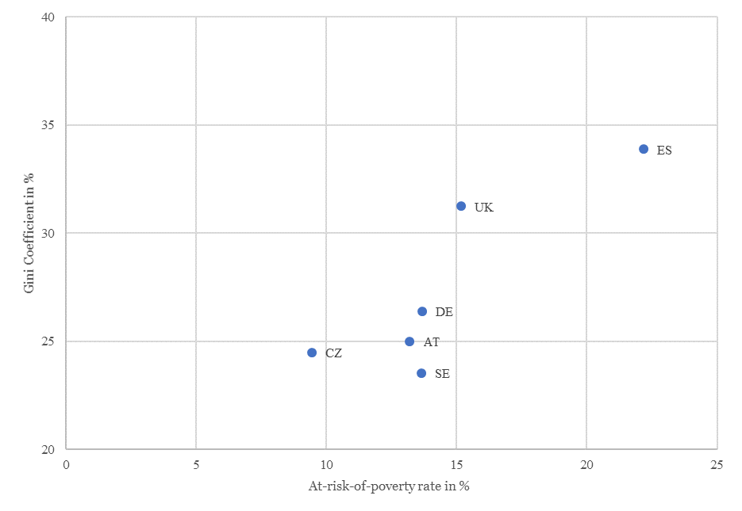
Baseline Poverty and Inequalty
Source: Authors’ calculations based on EUROMOD simulations.

Slide 7
Design of Income Tax System
Overall
  Negligible effects on poverty
  Flat tax increases income inequality
Household types
  Results not clear cut
  Tendency: Households with male active income contributor benefit from a flat tax
Intra-household perspective
  Flat tax favours main earner (typically men)

Slide 8
System of Household Taxation
Overall
  Negligible effects on poverty
  Joint taxation decreases income inequality
Household types
  2-adult households with 1 active earner typically benefit (lower taxes due to income splitting)
  Single households typically loose (higher tax rates)
Intra-household perspective
  Joint taxation favours main earner (typically men)

Slide 9
(Tax Related) Child Benefits
Replacing cash child benefit with tax related child benefit increases poverty and income inequality
The poverty and inequality increasing effect is larger for tax allowances than tax credits
Gender-differentiated effects not clear cut

Slide 10
Effect on Work Incentives
Gender Aspects
Tax benefit system affects labour supply decisions by altering gross incomes
What is the effect of a change in labour supply, i.e. in gross earnings, on disposable household income?
How much of the additional income is “taxed” away?

Slide 11
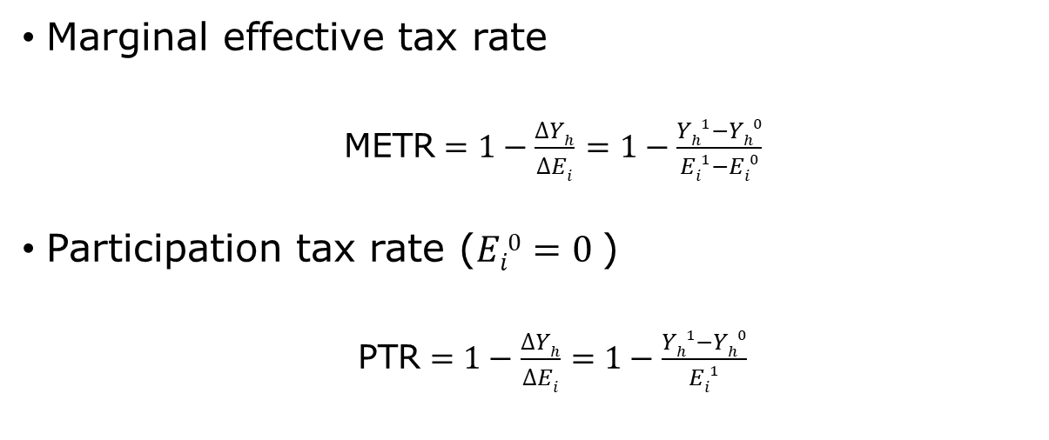
Effect on Work Incentives
Gender Aspects
Marginal effective tax rate
  $\text{METR}=1−\frac{∆Yh}{∆Ei}$ $=1−\frac{Yh1−Yh0}{Ei1−Ei0}$
Participation tax rate ($Ei0=0$)
  $\text{P}\text{TR}=1−\frac{∆Yh}{∆Ei}$ $=1−\frac{Yh1−Yh0}{Ei1}$

Slide 12
Effect on Work Incentives
Gender Aspects
Marginal effective tax rate
  Female second earners
  Earnings increased by 10%
Participation tax rate
  Inactive female in 2-adults household
  Earnings set to 2/3 of the national mean active income
Both indicators are sensitive to the assumed increase in earnings

Slide 13
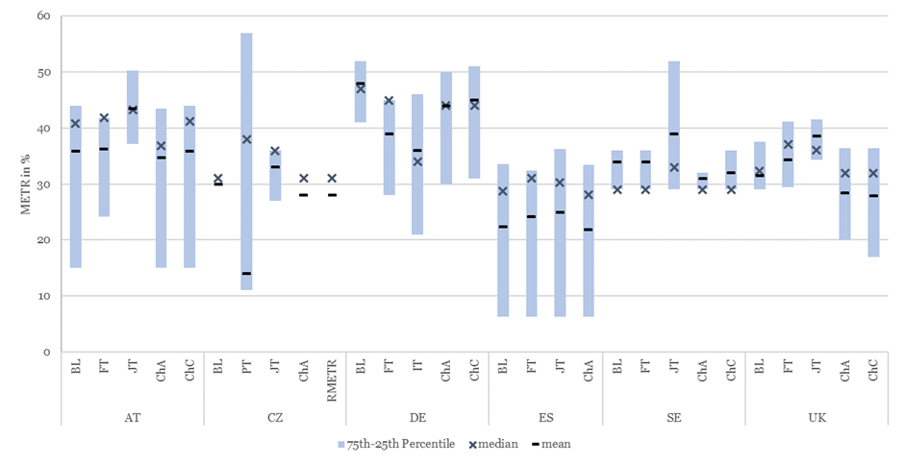
Distribution of METRs
Gender Aspects
Source: Authors’ calculations based on EUROMOD simulations.

Slide 14
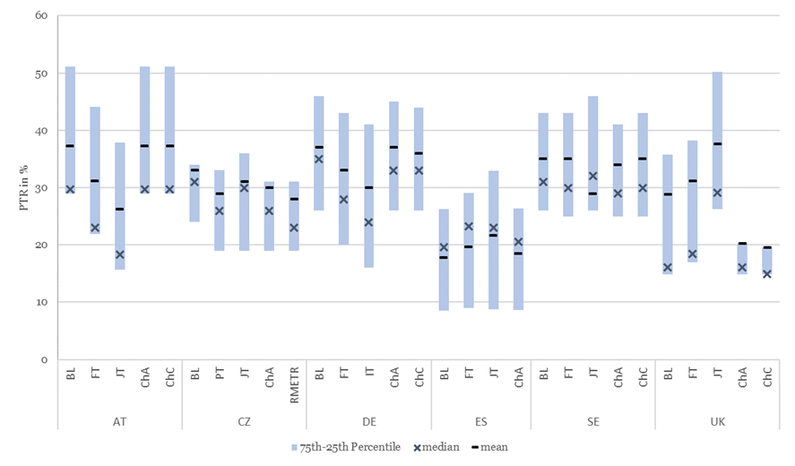
Distribution of PTRs
Gender Aspects
Source: Authors’ calculations based on EUROMOD simulations.

Slide 15
Summary
Extent of gender diff. varies across countries
Design of income tax system
  Poverty ~, Inequalty +, work incentive pronounced
System of household taxation
  Poverty ~, Inequalty -, work incentive pronounced
Design of (tax related) child benfits
  Poverty +, Inequality +, work incentive less pronounced

Slide 16
Thank you

Slide 17
Scenarios 1
BL | Baseline
FT | Switch from progressive to flat tax
PT | Switch from flat to progressive tax
JT | Switch from individual to joint taxation
IT | Switch from joint to individual taxation
RMETR | Sole earner tax credit abolished (budget neutrality via child tax credit)

Slide 18
Scenarios 2 (ChA)
AT | Child tax credit (de facto cash benefit) replaced by child tax allowance
cz | Child tax credit replaced by child tax allowance
De | Child benefit replaced by child tax allowance
Es | Family tax credit for children replaced by child tax allowance
Se | Child benefit replaced by child tax allowance
uk | Child tax credit (means-tested benefit) replaced by child tax allowance

Slide 19
Scenarios 2 (ChC)
AT | Child tax allowances replaced by new child tax credit
cz | -
De | Child benefit replaced by child tax credit
Es | -
Se | Child benefit replaced by child tax credit
uk | Child tax credit (means-tested benefit) replaced by child tax credit

