Slide 1
BAF Biogeochemical Analytical Facility
Department of Ecology and Environmental Science (EMG)
A part of the KBC infrastructure

Slide 2
BAF – background
The aquatic research groups at EMG started to build up on existing instrument park for chemical water analyses in 2008, with a TOC-analyzer and a gas chromatograph.
In 2012 the first steps towards a department common instrument park was formed (and the first bills was sent out).
BAF became a part of the KBC-infrastructure in 2017.
By the end of 2017 the existing instrumental facilities came in place.

Slide 3
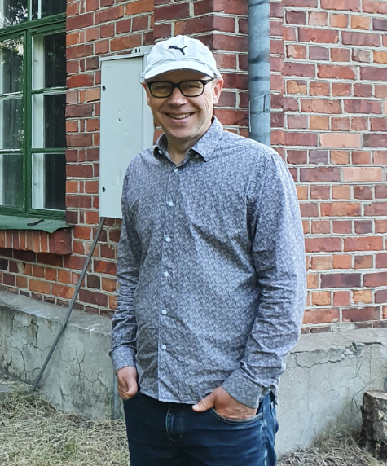
BAF
Steering comittee
Prof. Ann-Kristin Bergström (EMG), manager
Prof. Jan Karlsson (EMG)
Prof. Reiner Giesler (EMG)
Dr. Anders Jonsson (EMG)
Prof. Jurgen Schleucher (Medical Biochemistry and Biophysics)
Technician
Dr. Anders Jonsson

Slide 4
What do the facility comprise of?
* A number of instruments for wet/dry chemical/biological analyses
- organic carbon
- nutrients
- green house gases
- bacteria/algae nos and biomass
- absorbance/fluorescence
* Some basic laboratory facilities, balances, clean water, autoclave…

Slide 5
The most important instruments - function and limitations

Slide 6
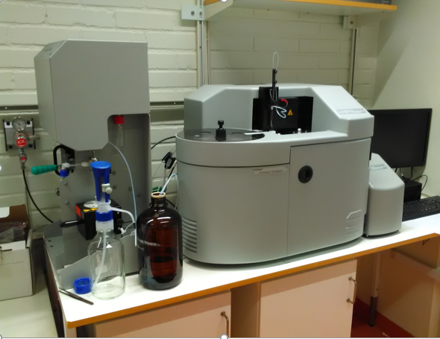
BAF – the instrument facilities Can be operated after certificate is taken
TOC analyzer (2017)
FORMACS HT-I (Skalar)
ND 25 detector unit
Primacs module
Autosampler for 80 samples
IR-detector
Chemiluminiscent detector
Substance Detection
TOC 0.1 mg C/L
TN 0.05 mg N/L
POC 15 µg C
DIC 0.1 mg C/L

Slide 7
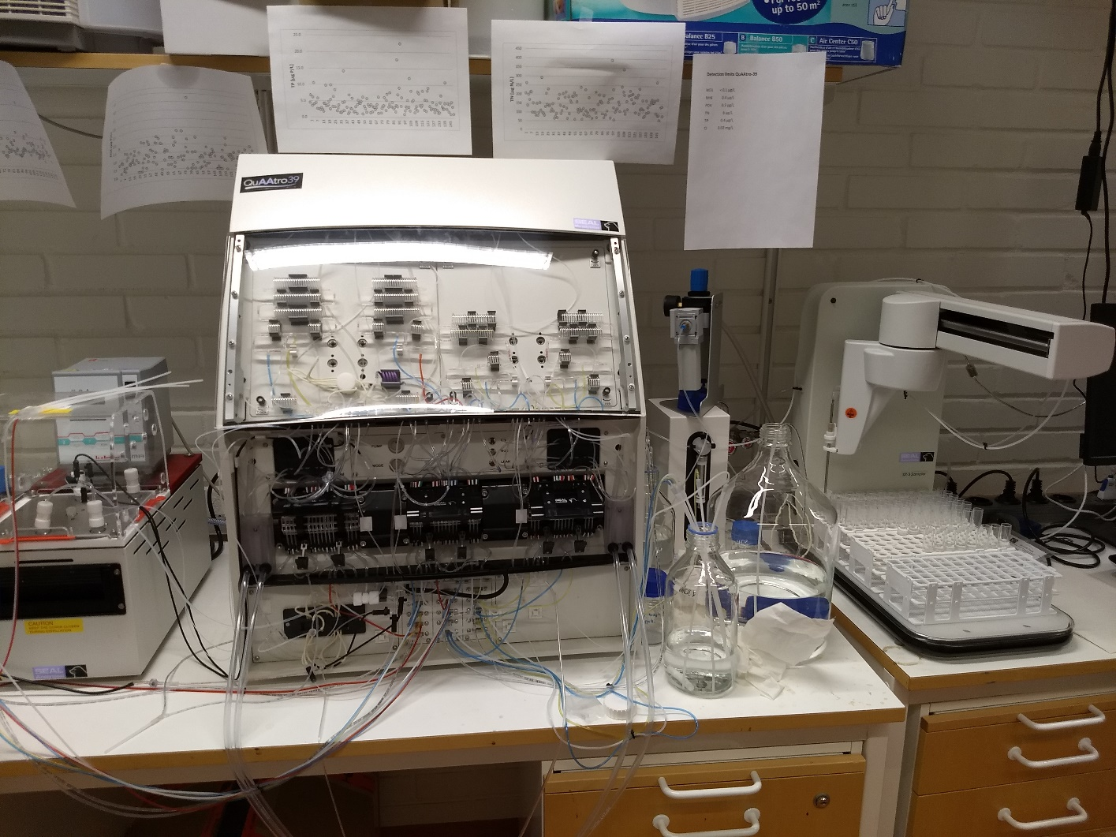
BAF – the instrument facilities No certificate can be taken
Nutirent analyzer (2017)
QuAAtro 39 (Seal Analytical)
Segmented flow analyzer
Autosampler 180 samples
Diluter 10-200 times
Digestion unit
Detection
NO3+NO2 0.2 µg N/L
NH4 0.4 µg N/L
PO4 0.3 µg P/L
TN 6 µg N/L
TP 0.4 µg P/L

Slide 8
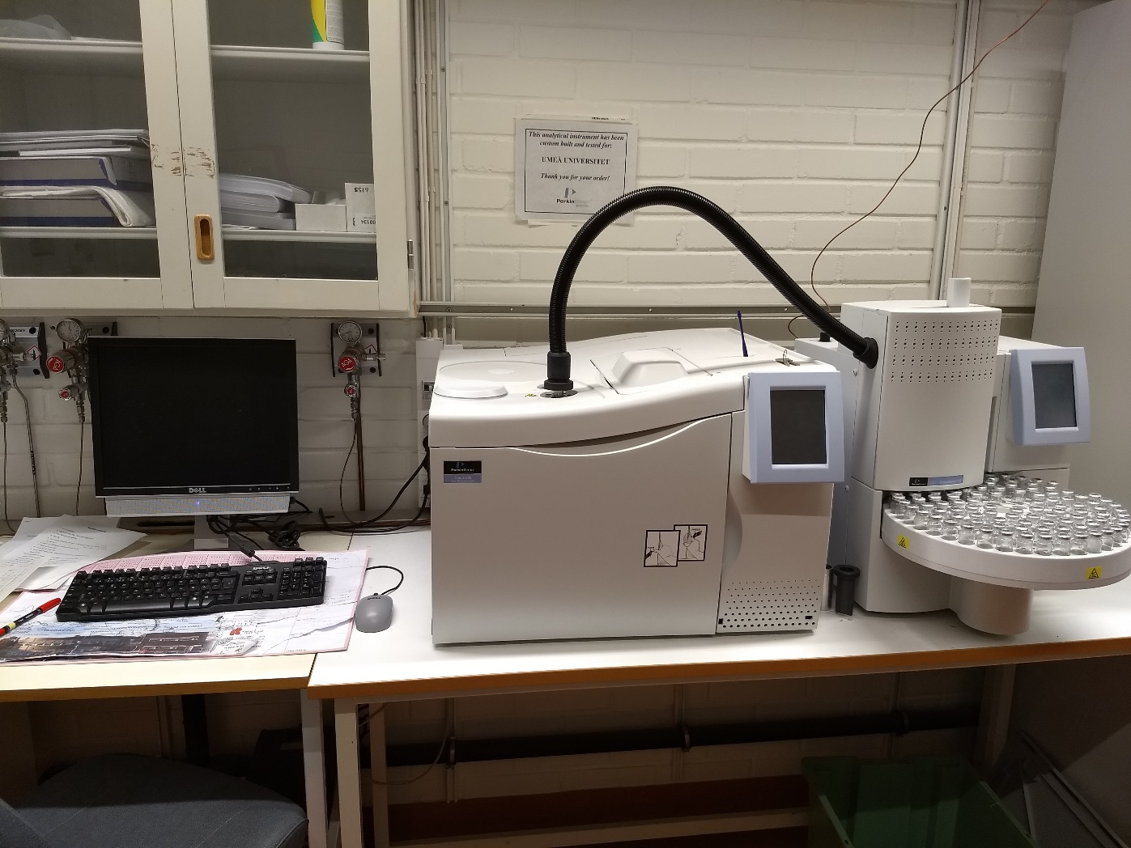
BAF – the instrument facilities Can be operated after a certificate is taken
Gas chromatograph (2008)
Clarus 500 (Perkin Elmer)
22 mL sample vials (maximum 10 mL
liquid)
110 samples headspace sampler
Two injector ports
Two capillary Q-Plot columns
N2-carrier gas
FID for CO2/CH4
ECD for N2O (equipped with a make
up gas flow of Ar/5% CH4)

Slide 9
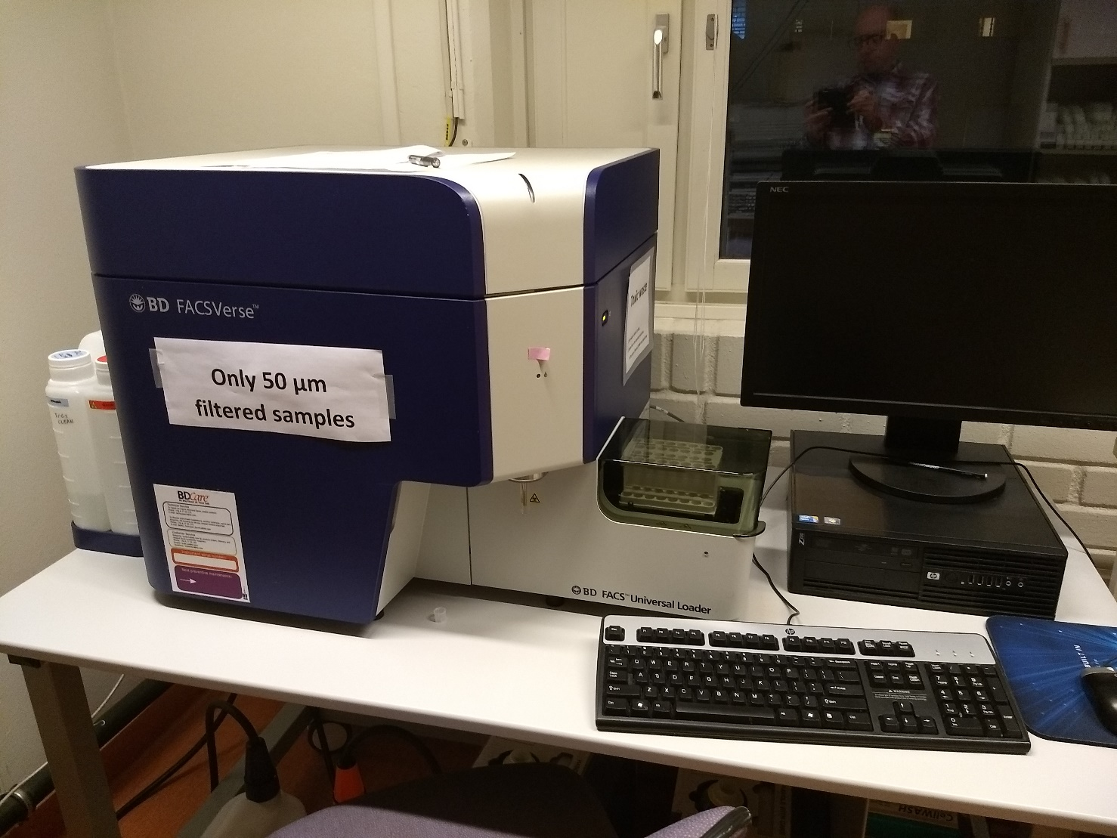
BAF – the instrument facilities Can be operated after a certificate is taken
Flow Cytometer (2012)
FacsVerse (BD)
Blue and red lasers
Autosampler up to 40 samples/
96 well plate sampler
Manual port 50, 5 or 2 mL tubes
High 120 µL/min
Medium 60 µL/min
Low 12 µL/min
Analyzing
Forward/side scatter and 6 colors
Particles < 50 µm

Slide 10
BAF – the instrument facilities
Other facilites
Brand
Liquid scintillation counter
(radioactive decay, 14C, 3H) Beckman LS 6500
Fluormeter PerkinElmer LS-55 (with plate reader)
Spectrophotometer Jasco VS-560, (VS-650, autosampler)
Microbalance (0.5 µg) Mettler
Respicond facility (for measuring respiration)
Freeze drier, autoclave, incubation cabinets, muffel furnace...

Slide 11
Cost for analyses
Price list for analyses (SEK)
The cost for analyses include consumables, maintenance and service + a cost for having samples analyzed by technician.
Instrument Analysis Price
QuAAtro-39 TN/TP 30/element + 25
QuAAtro-39 NO3+NO2/NH4/PO4 20/substance + 25
Formacs HT-I TOC/TN/POC/DIC 30/element +25
FacsVerse Flow cytometer 30/sample + 25
Clarus 500 DIC/CO2/CH4/N2O 30/substance + 25
User fee for other equipments, annual fee (5000 SEK for 1-2 users, 10,000 SEK for 3-5 users, 15,000 SEK for >6 users) or daily fee of 100 SEK/equipment

Slide 12
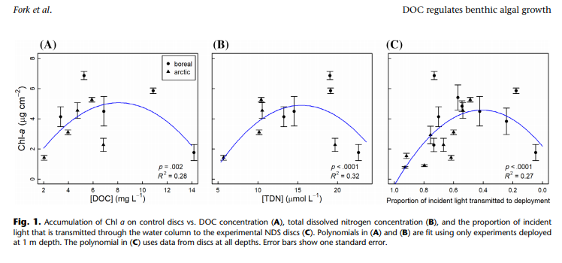
Examples

Slide 13
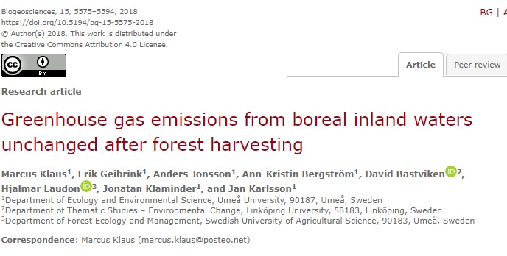
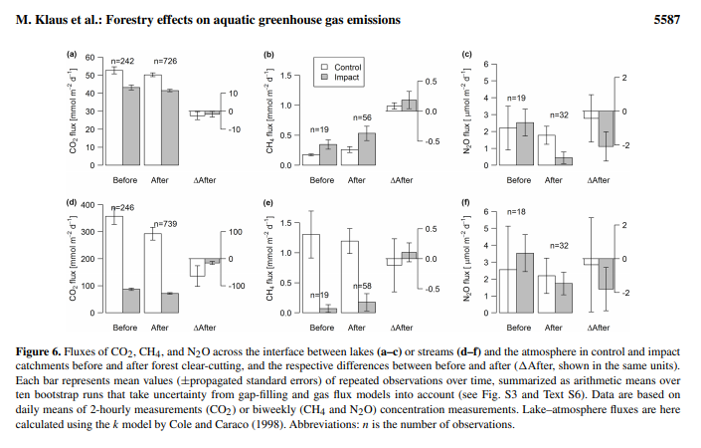
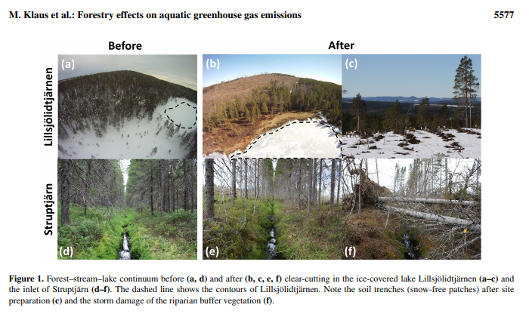
Examples

Slide 14
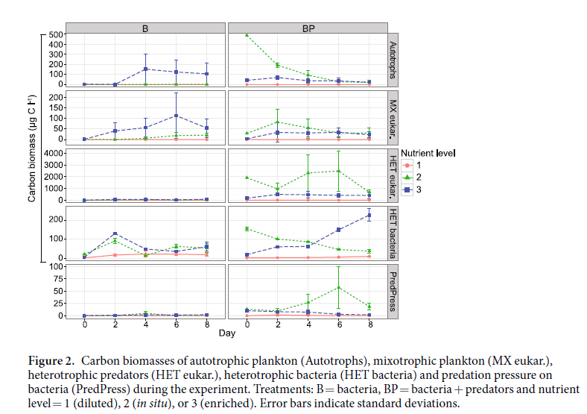
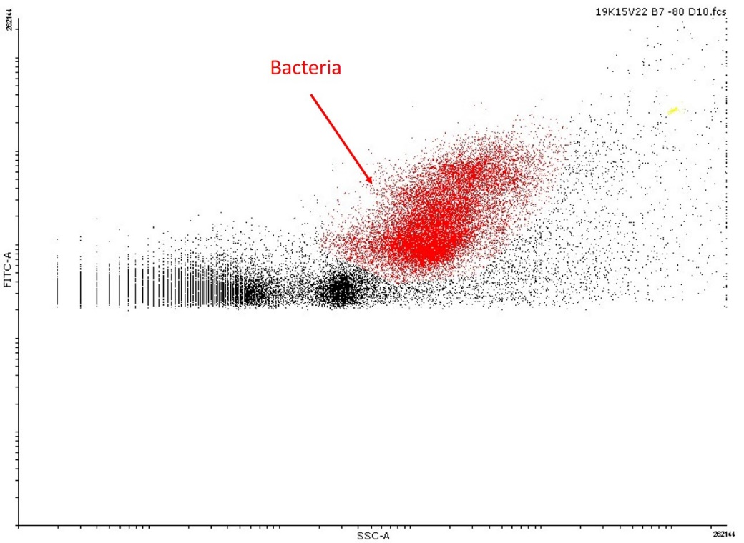
Example

Slide 15
Questions? anders.jonsson@umu.se

